Slide 1
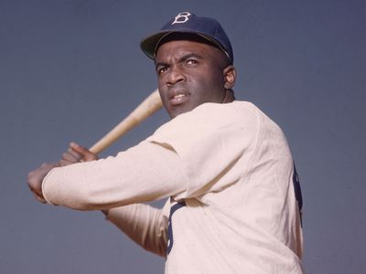
Jackie Robinson

Slide 2
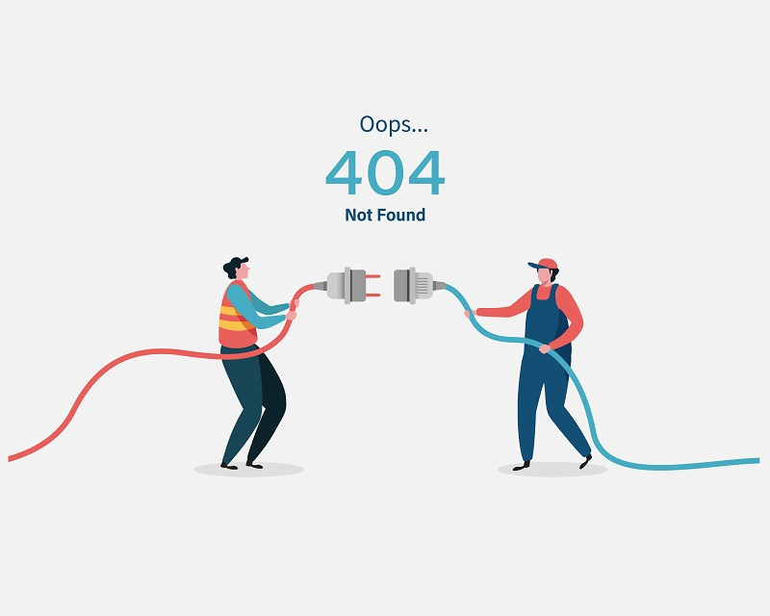
Early life
His childhood photos

Slide 3
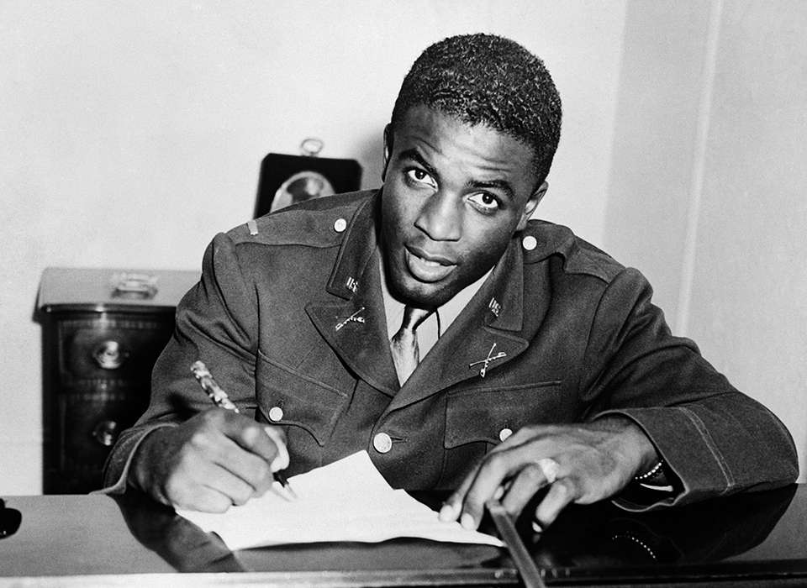
US army

Slide 4

Brooklyn Dodgers

Slide 5
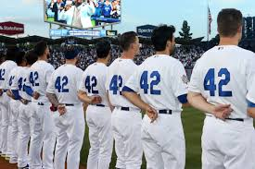
jackie robinson day

